Slide 1
HOMOSEXUALITY
Opening the Door
Outcomes
All students understand what it feels like to ‘come out’ and speak openly about being homosexual
Most students can identify strategies for having discussions about their sexuality with their friends, family and others
Most students can identify strategies for how to listen to and support others with their sexuality
Some students can articulate a variety of different perspectives on the topic of ‘coming out’
https://www.youtube.com/watch?v=mINGKrtG3iw

Slide 2
Starter Add your post-it note to the board
How do you think you would feel about talking to your friends and family about your sexuality if you thought that you might be homosexual or bisexual?

Slide 3
What do the following keywords mean?
Homosexual
Bisexual
Heterosexual
Gay
Trans

Slide 4
Answers
Homosexual - Someone who has an emotional, romantic and/or sexual orientation towards someone of the same gender.
Bisexual - Refers to a person who has an emotional and/or sexual orientation towards people of more than one gender
Heterosexual - Someone who has an emotional, romantic and/or sexual orientation towards someone of the opposite gender.
Gay – a different word for being homosexual
Trans – An umbrella term to describe people whose gender is not the same as, or does not sit comfortably with, the sex they were assigned at birth.

Slide 5
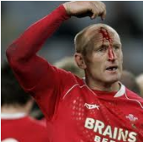
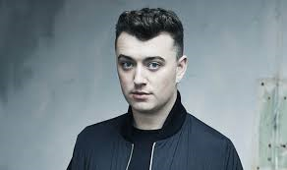
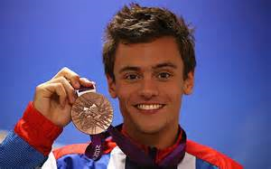
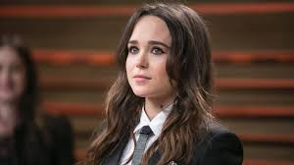
Gareth Thomas
Cara Delevigne
Sam Smith
Who are these people? What do they do?
Tom Daley
Ellen Page

Slide 6
Video 1
https://youtu.be/3tvqY5lF9fk
All = How do you think Richard was feeling before telling his parents he was gay? How could you tell?
All = Where were they when he told them?
Some = Why did his parents react this way?

Slide 7
Video 2
https://youtu.be/Bz1bkHRwP6I
All = List all the different ways that the different parents reacted
Most = How did most parents react?
Some = What were some parents worried about?

Slide 8
Video 3
https://youtu.be/Dp4s8yiDnUA
Some = How do a lot of people feel when they come out?
All = How did these people tell others about their sexuality?

Slide 9
Task
Write a fictional letter to a friend explaining that you suspect you are gay. Explain how you are feeling in the letter.
Write a reply to this letter giving advice to your friend.

Slide 10
Plenary Add your post-it note to the board
What are your top 3 tips for talking to your friends and family about your sexuality?

